Slide 1
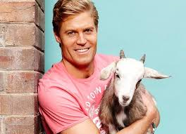
Chris Brown
Karin Pajerská
8.B
2013/2014

Slide 2
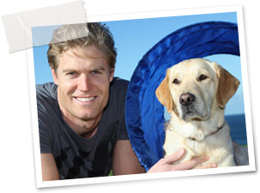
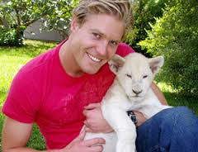
Content
Who is Chris Brown
Why I choose him
His own program
Photo gallery

Slide 3
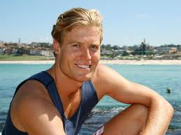
Who is Chris Brown
Chris Brown is an actor, writer and veterinary doctor. He was born in September 1978 in Newcastle in Australia. His father was a local veterinary doctor. He has had an own animal clinic SASH (small animal speciallist hospital) on Bondi Beach in Australia.

Slide 4
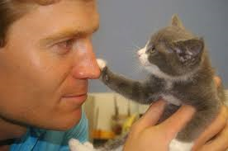
Why I choose him
I choose him because he is my favourite veterinary doctor and he is successful guest in different program. He is my pattern. I like his work, his way of working, his family and friendly approach. I like his passion for work. I like his program on my favourite channel Animal Planet.

Slide 5
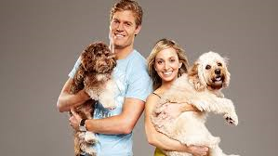
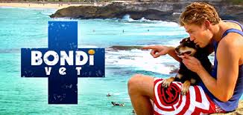
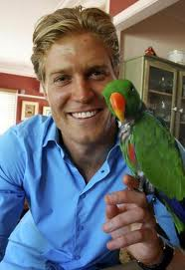
His own program
Chris Brown has own program on channel Animal Planet - Bondi vet or Veterinary from Bondi Beach. His program show his work on SASH (his veterinary clinic) with his veterinary partner Lisa Chimes and his team. They have rescued many animals.

Slide 6
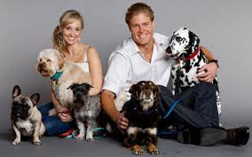
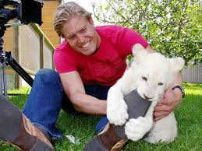
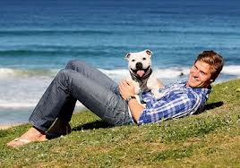
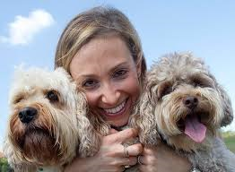
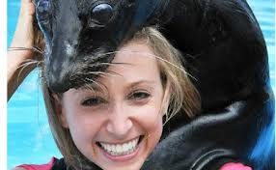
Photo gallery ...

Slide 7
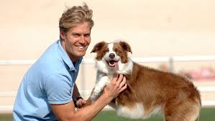
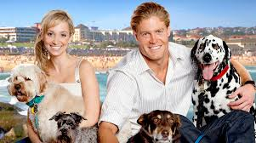
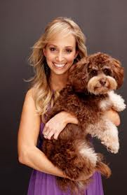
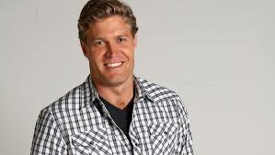
... and more.

Slide 8
THANK YOU FOR YOUR ATTENTION AND I HOPE YOU LIKE MY PRESENTATION

